Slide 1


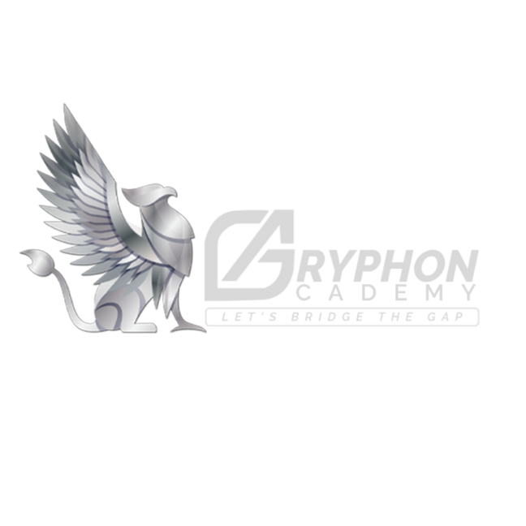
Warm Welcome to
Students
Git Interview Preparation

Slide 2

Engineer your path to triumph with technical trainings, transforming raw potential into precision and finesse
Technical session by-
Mr. Sachin Lohar

Slide 3
Git Introduction
Installation
Git Commonds
GitHun
Important Interview Preparation
Questions
Technical session by-
Mr. Sachin Lohar

Slide 4

What is Flutter?
In general, creating a mobile application is a very complex and challenging task. There are many frameworks available, which provide excellent features to develop mobile applications. For developing mobile apps, Android provides a native framework based on Java and Kotlin language, while iOS provides a framework based on Objective-C/Swift language. Thus, we need two different languages and frameworks to develop applications for both OS. Today, to overcome form this complexity, there are several frameworks have introduced that support both OS along with desktop apps. These types of the framework are known as cross-platform development tools.
The cross-platform development framework has the ability to write one code and can deploy on the various platform (Android, iOS, and Desktop). It saves a lot of time and development efforts of developers. There are several tools available for cross-platform development, including web-based tools, such as Ionic from Drifty Co. in 2013, Phonegap from Adobe, Xamarin from Microsoft, and React Native form Facebook. Each of these frameworks has varying degrees of success in the mobile industry. In recent, a new framework has introduced in the cross-platform development family named Flutter developed from Google.

Slide 5
Flutter is a UI toolkit for creating fast, beautiful, natively compiled applications for mobile, web, and desktop with one programing language and single codebase. It is free and open-source. It was initially developed from Google and now manages by an ECMA standard. Flutter apps use Dart programming language for creating an app. The dart programming shares several same features as other programming languages, such as Kotlin and Swift, and can be trans-compiled into JavaScript code.
Flutter is mainly optimized for 2D mobile apps that can run on both Android and iOS platforms. We can also use it to build full-featured apps, including camera, storage, geolocation, network, third-party SDKs, and more.

Slide 6
What makes Flutter unique?
Flutter is different from other frameworks because it neither uses WebView nor the OEM widgets that shipped with the device. Instead, it uses its own high-performance rendering engine to draw widgets. It also implements most of its systems such as animation, gesture, and widgets in Dart programing language that allows developers to read, change, replace, or remove things easily. It gives excellent control to the developers

Slide 7
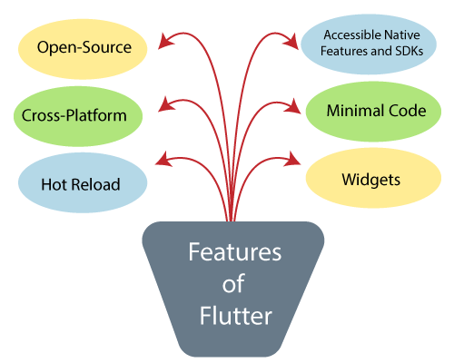
Features of Flutter
Flutter gives easy and simple methods to start building beautiful mobile and desktop apps with a rich set of material design and widgets. Here, we are going to discuss its main features for developing the mobile framework.

Slide 8
Open-Source: Flutter is a free and open-source framework for developing mobile applications.
Cross-platform: This feature allows Flutter to write the code once, maintain, and can run on different platforms. It saves the time, effort, and money of the developers.
Hot Reload: Whenever the developer makes changes in the code, then these changes can be seen instantaneously with Hot Reload. It means the changes immediately visible in the app itself. It is a very handy feature, which allows the developer to fix the bugs instantly.
Accessible Native Features and SDKs: This feature allows the app development process easy and delightful through Flutter's native code, third-party integration, and platform APIs. Thus, we can easily access the SDKs on both platforms.

Slide 9
Minimal code: Flutter app is developed by Dart programming language, which uses JIT and AOT compilation to improve the overall start-up time, functioning and accelerates the performance. JIT enhances the development system and refreshes the UI without putting extra effort into building a new one.
Widgets: The Flutter framework offers widgets, which are capable of developing customizable specific designs. Most importantly, Flutter has two sets of widgets: Material Design and Cupertino widgets that help to provide a glitch-free experience on all platforms.

Slide 10
Advantage of Flutter
Flutter fulfills the custom needs and requirements for developing mobile applications. It also offers many advantages, which are listed below.
It makes the app development process extremely fast because of the hot-reload feature. This feature allows us to change or update the code are reflected as soon as the alterations are made.
It provides the smoother and seamless scrolling experiences of using the app without much hangs or cuts, which makes running applications faster in comparison to other mobile app development frameworks.
Flutter reduces the time and efforts of testing. As we know, flutter apps are cross-platform so that testers do not always need to run the same set of tests on different platforms for the same app.
It has an excellent user interface because it uses a design-centric widget, high-development tools, advanced APIs, and many more features.
It is similar to a reactive framework where the developers do not need to update the UI content manually.
It is suitable for MVP (Minimum Viable Product) apps because of its speedy development process and cross-platform nature.

Slide 11
Disadvantages of Flutter
We have seen earlier that the Flutter has many advantages, but it also contains some disadvantages, which are given below.
The Flutter is a comparatively new language that needs continuous integration support through the maintenance of scripts.
It provides very limited access to SDK libraries. It means a developer does not have a lot of functionalities to create a mobile application. Such types of functionalities need to be developed by the Flutter developer themselves.
The Flutter apps do not support the browser. It only supports Android and iOS platforms.
It uses Dart programming for coding, so a developer needs to learn new technologies. However, it is easy to learn for developers.

Slide 12
Flutter Architecture
The Flutter architecture mainly comprises of four components.
Flutter Engine
Foundation Library
Widgets
Design Specific Widgets
Flutter Engine
It is a portable runtime for high-quality mobile apps and primarily based on the C++ language. It implements Flutter core libraries that include animation and graphics, file and network I/O, plugin architecture, accessibility support, and a dart runtime for developing, compiling, and running Flutter applications. It takes Google's open-source graphics library, Skia, to render low-level graphics.

Slide 13
Foundation Library
It contains all the required packages for the basic building blocks of writing a Flutter application. These libraries are written in Dart language.
Widgets
In Flutter, everything is a widget, which is the core concept of this framework. Widget in the Flutter is basically a user interface component that affects and controls the view and interface of the app. It represents an immutable description of part of the user interface and includes graphics, text, shapes, and animations that are created using widgets. The widgets are similar to the React components.

Slide 14
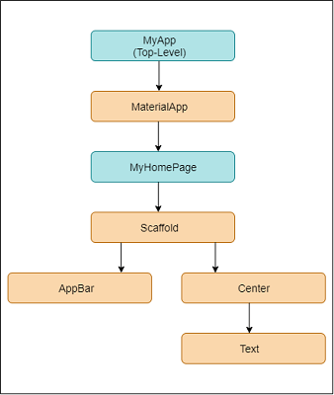
In Flutter, the application is itself a widget that contains many sub widgets. It means the app is the top-level widget, and its UI is build using one or more children widgets, which again includes sub child widgets. This feature helps you to create a complex user interface very easily.
We can understand it from the hello world example created in the previous section. Here, we are going to explain the example with the following diagram.
In the above example, we can see that all the components are widgets that contain child widgets. Thus, the Flutter application is itself a widget.

Slide 15
Design Specific Widgets
The Flutter framework has two sets of widgets that conform to specific design languages. These are Material Design for Android application and Cupertino Style for IOS application.
Gestures
It is a widget that provides interaction (how to listen for and respond to) in Flutter using GestureDetector. GestureDector is an invisible widget, which includes tapping, dragging, and scaling interaction of its child widget. We can also use other interactive features into the existing widgets by composing with the GestureDetector widget.
State Management
Flutter widget maintains its state by using a special widget, StatefulWidget. It is always auto re-rendered whenever its internal state is changed. The re-rendering is optimized by calculating the distance between old and new widget UI and render only necessary things that are changes.

Slide 16
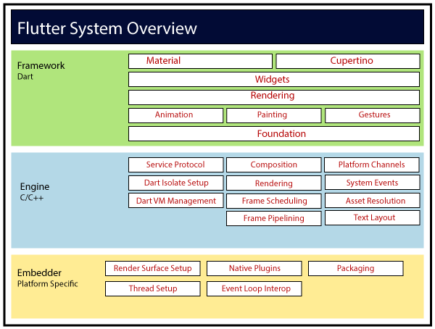
Layers
Layers are an important concept of the Flutter framework, which are grouped into multiple categories in terms of complexity and arranged in the top-down approach. The topmost layer is the UI of the application, which is specific to the Android and iOS platforms. The second topmost layer contains all the Flutter native widgets. The next layer is the rendering layer, which renders everything in the Flutter app. Then, the layers go down to Gestures, foundation library, engine, and finally, core platform-specific code. The following diagram specifies the layers in Flutter app development.

Slide 17
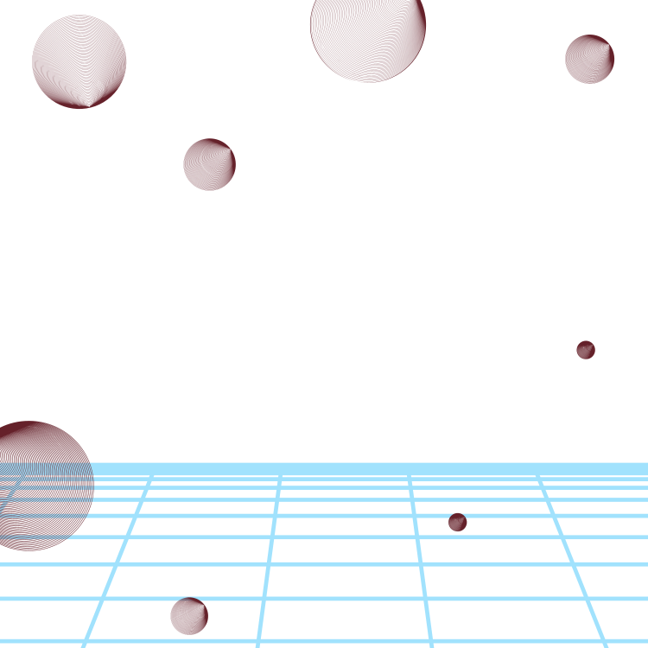
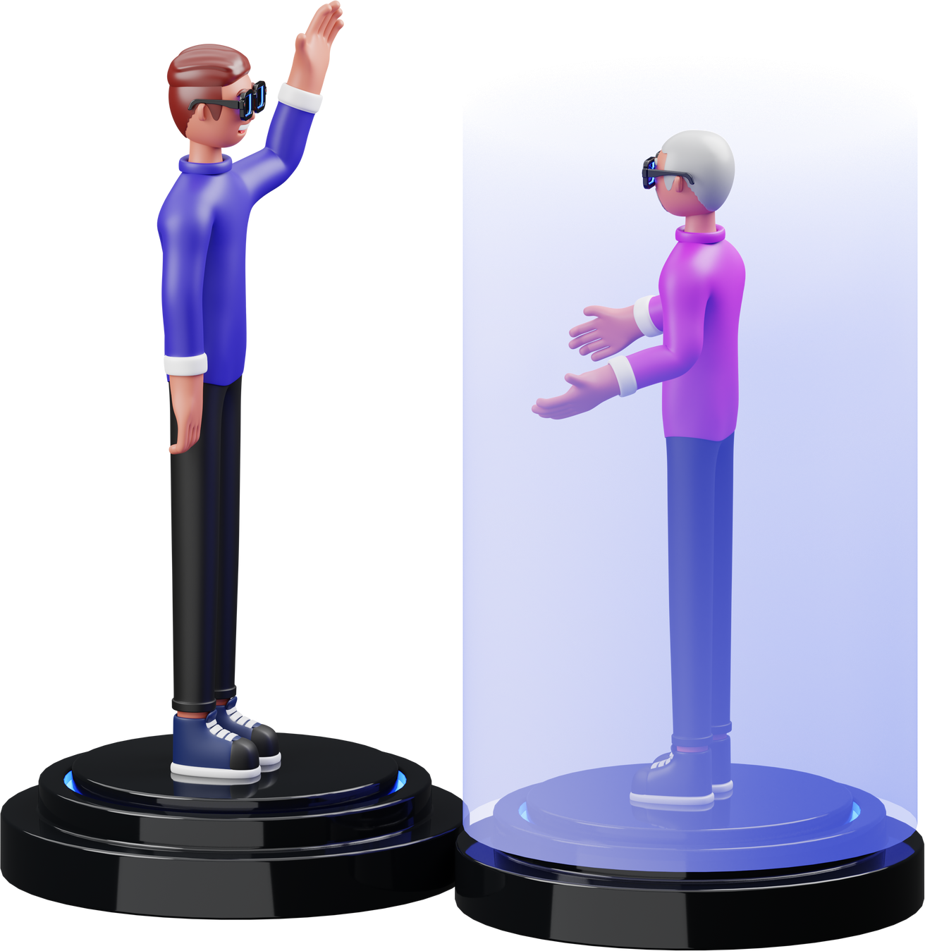
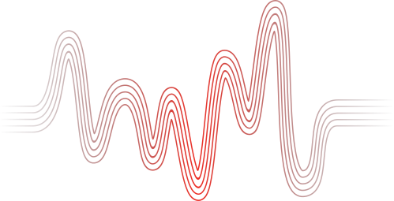


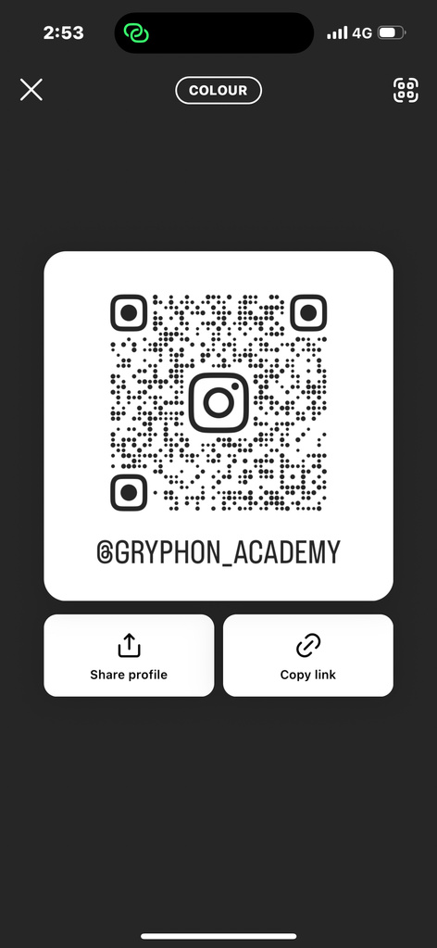
GET IN TOUCH
WITH US
Phone Number
8933614509
Email Address
connect@gryphonacademy.co.in
Instagarm
gryphon_academy

